Slide 1
Pushing Left, Like a Boss
Application Security Foundations
Speaker:
Mario Platt
Author:
Tanya Janca

Slide 2
Who am I ?
Interest in security since late 90s
Multiple roles – sys admin, trainer, pen-tester, product manager, security operations, security engineering, network security, security management, governance, risk management, compliance, consulting
Founder @ PrivacyBeacon.io
Director of Cyber Security @ Broadlight.io
Open-source and standards contributor – Hacker Highschool, ISO 27000, GDPR Patterns now GraphRisk, Wardley mapping (Strategy) for Security @ OpenSecuritySummit, more to come

Slide 3
What is “Pushing Left”?
If you imagine the SDLC written out on a piece of paper, the further left you go, the earlier you are in the System Development Life Cycle.
Requirements
Design
Code
Testing
Release
’Pushing Left’ means the security team wants to be invited to the party earlier, and stay until the end.

Slide 4

What are we going to talk about today?
The foundations of
application security.

Slide 5
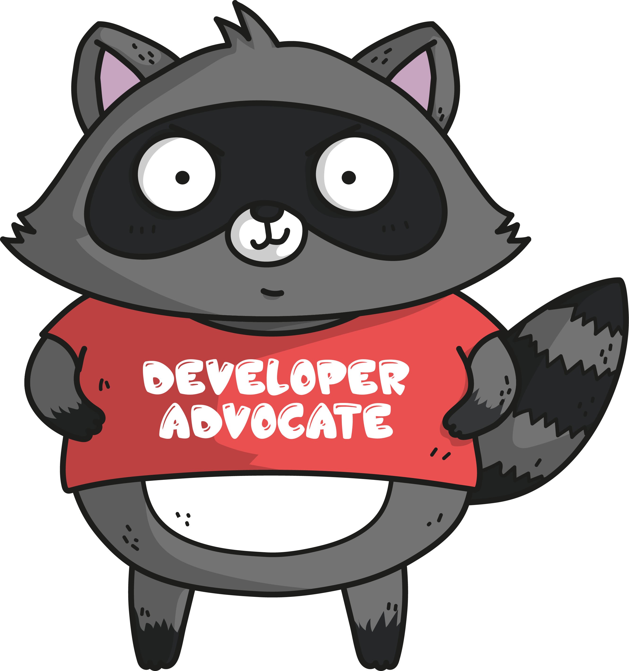
The Current State of Affairs

Slide 6

The current state: Everyone is “getting hacked”
#WOCinTechChat
Notes:
Current state of affairs: a review for most, but I want to make sure we a real on the same page
Everyone is “getting hacked”, and it is often poorly-written web applications that are the cause.
Did you know approx. ¼ of all incidents are cause of software vulnerabilities? Is your security team spending 25% of your budget on it? Why not?

Slide 7
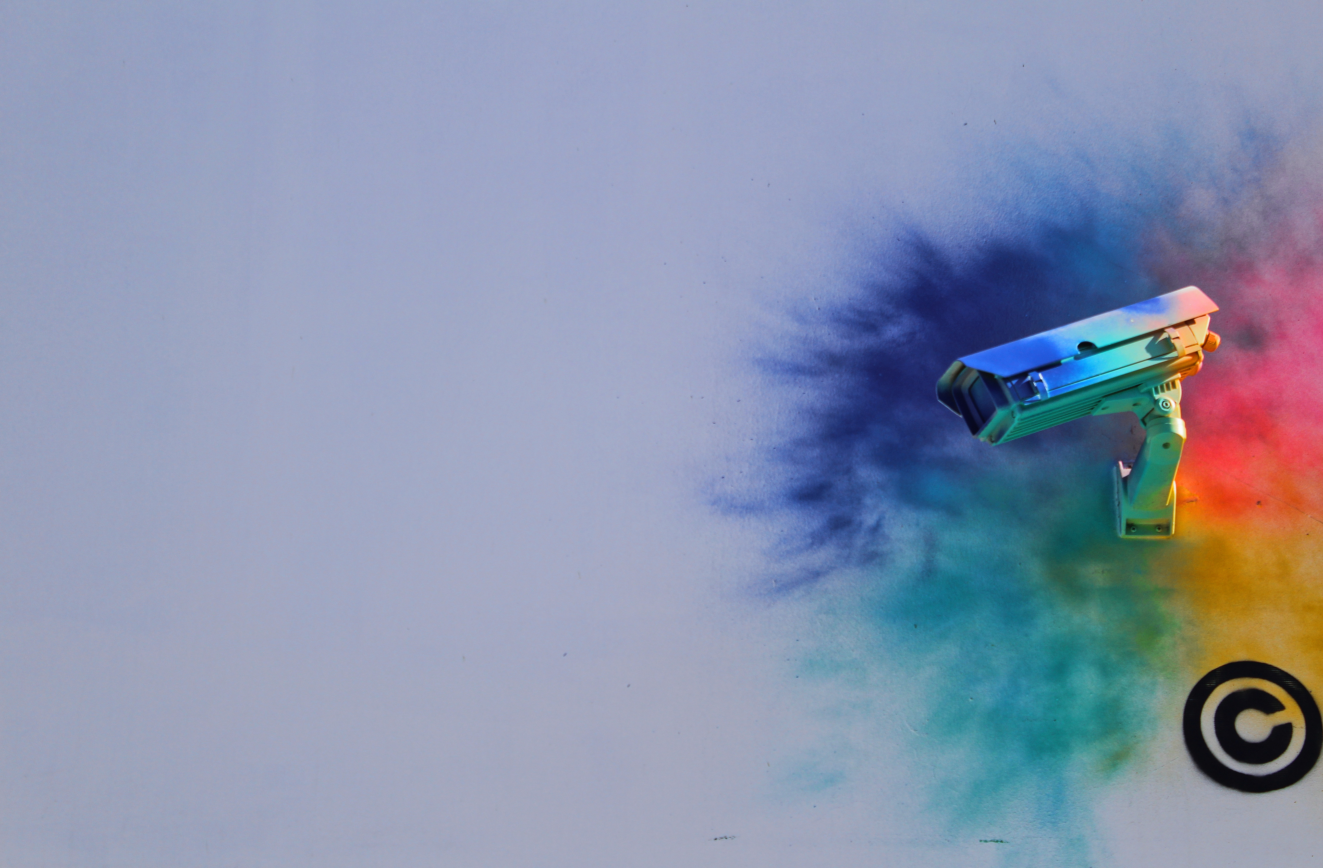
The current state:
We’re looking
the wrong way.
Unsplash
Notes:
Many security teams concentrate on the perimeter, networks and infrastructure. Patch management and vendor-supplied solutions receive most of their attention. Most have little knowledge of application security.
It's like locking your front door but then leaving all the windows open on the main floor.

Slide 8
What IS AppSec?
“Application security encompasses measures taken to improve the security of an application often by finding, fixing and preventing security vulnerabilities.”
- From Wikipedia
Notes:
It's something that the security team really wants the developers to take care of, and that the developers are often unaware of or underprepared for.
“Application security are any of the activities that you do to ensure that the software you create is secure. Security testing, code review, etc, all of that is "AppSec".

Slide 9
What IS AppSec?
“It’s any and every activity that you perform to ensure that your software is secure.”
-Tanya Janca
Notes:
It's something that the security team really wants the developers to take care of, and that the developers are often unaware of or underprepared for.
“Application security are any of the activities that you do to ensure that the software you create is secure. Security testing, code review, etc, all of that is "AppSec".

Slide 10
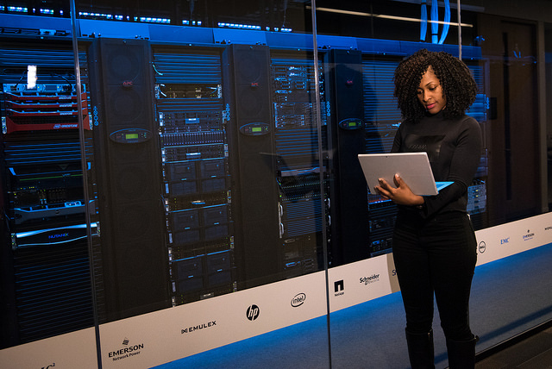
The current state: Penetration Testing
#WOCinTechChat
Notes:
Often a Penetration Tester (ethical hacker) is hired right before something goes into production, and this is the first time security has been tested. When the report comes in there is not enough time to fix most of the items, so the developers do a few last minute bug fixes and release it anyway, with a plan to fix the rest in the next build. Sure...
This is far from ideal.
Sometimes they don't even hire a PenTester, and the application is never tested at all. Ouch.

Slide 11
The current state: CIA
Confidentiality
Availability
CIA
Integrity
Notes:
The reason the IT Security team hassles you about secure coding is because of their mandate to protect the Confidentiality, Integrity and Availability (CIA) of systems and data.
Confidentiality – What if someone else saw your personal information? Without your permission?
Integrity - What if your personal information was changed? By someone other than you?
Availability – What if you couldn't even get to the app at all?

Slide 12
What is “Pushing Left”?
If you imagine the SDLC written out on a piece of paper, the further left you go, the earlier you are in the System Development Life Cycle.
Requirements
Design
Code
Testing
Release
’Pushing Left’ means the security team wants to be invited to the party earlier, and stay until the end.

Slide 13

Pushing Left…. Like a Boss!
#WOCinTechChat
Notes:
So.... How do we push left like a boss?
You launch an AppSec program, which are basically extra activities that become part of the SDLC which support developers to create software that is more secure. The security team does some of them and the developers do some of them, and at the end we have better software.

Slide 14
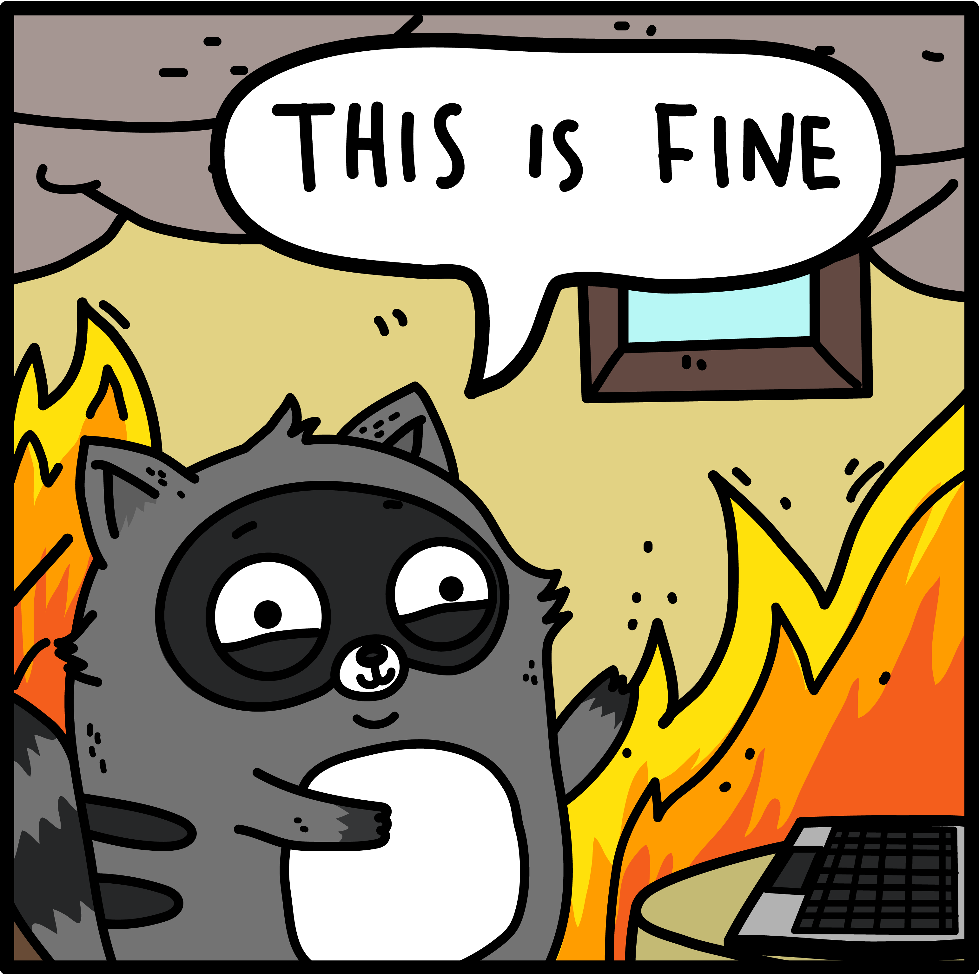
An AppSec Program
Formalizing Security Activities

Slide 15
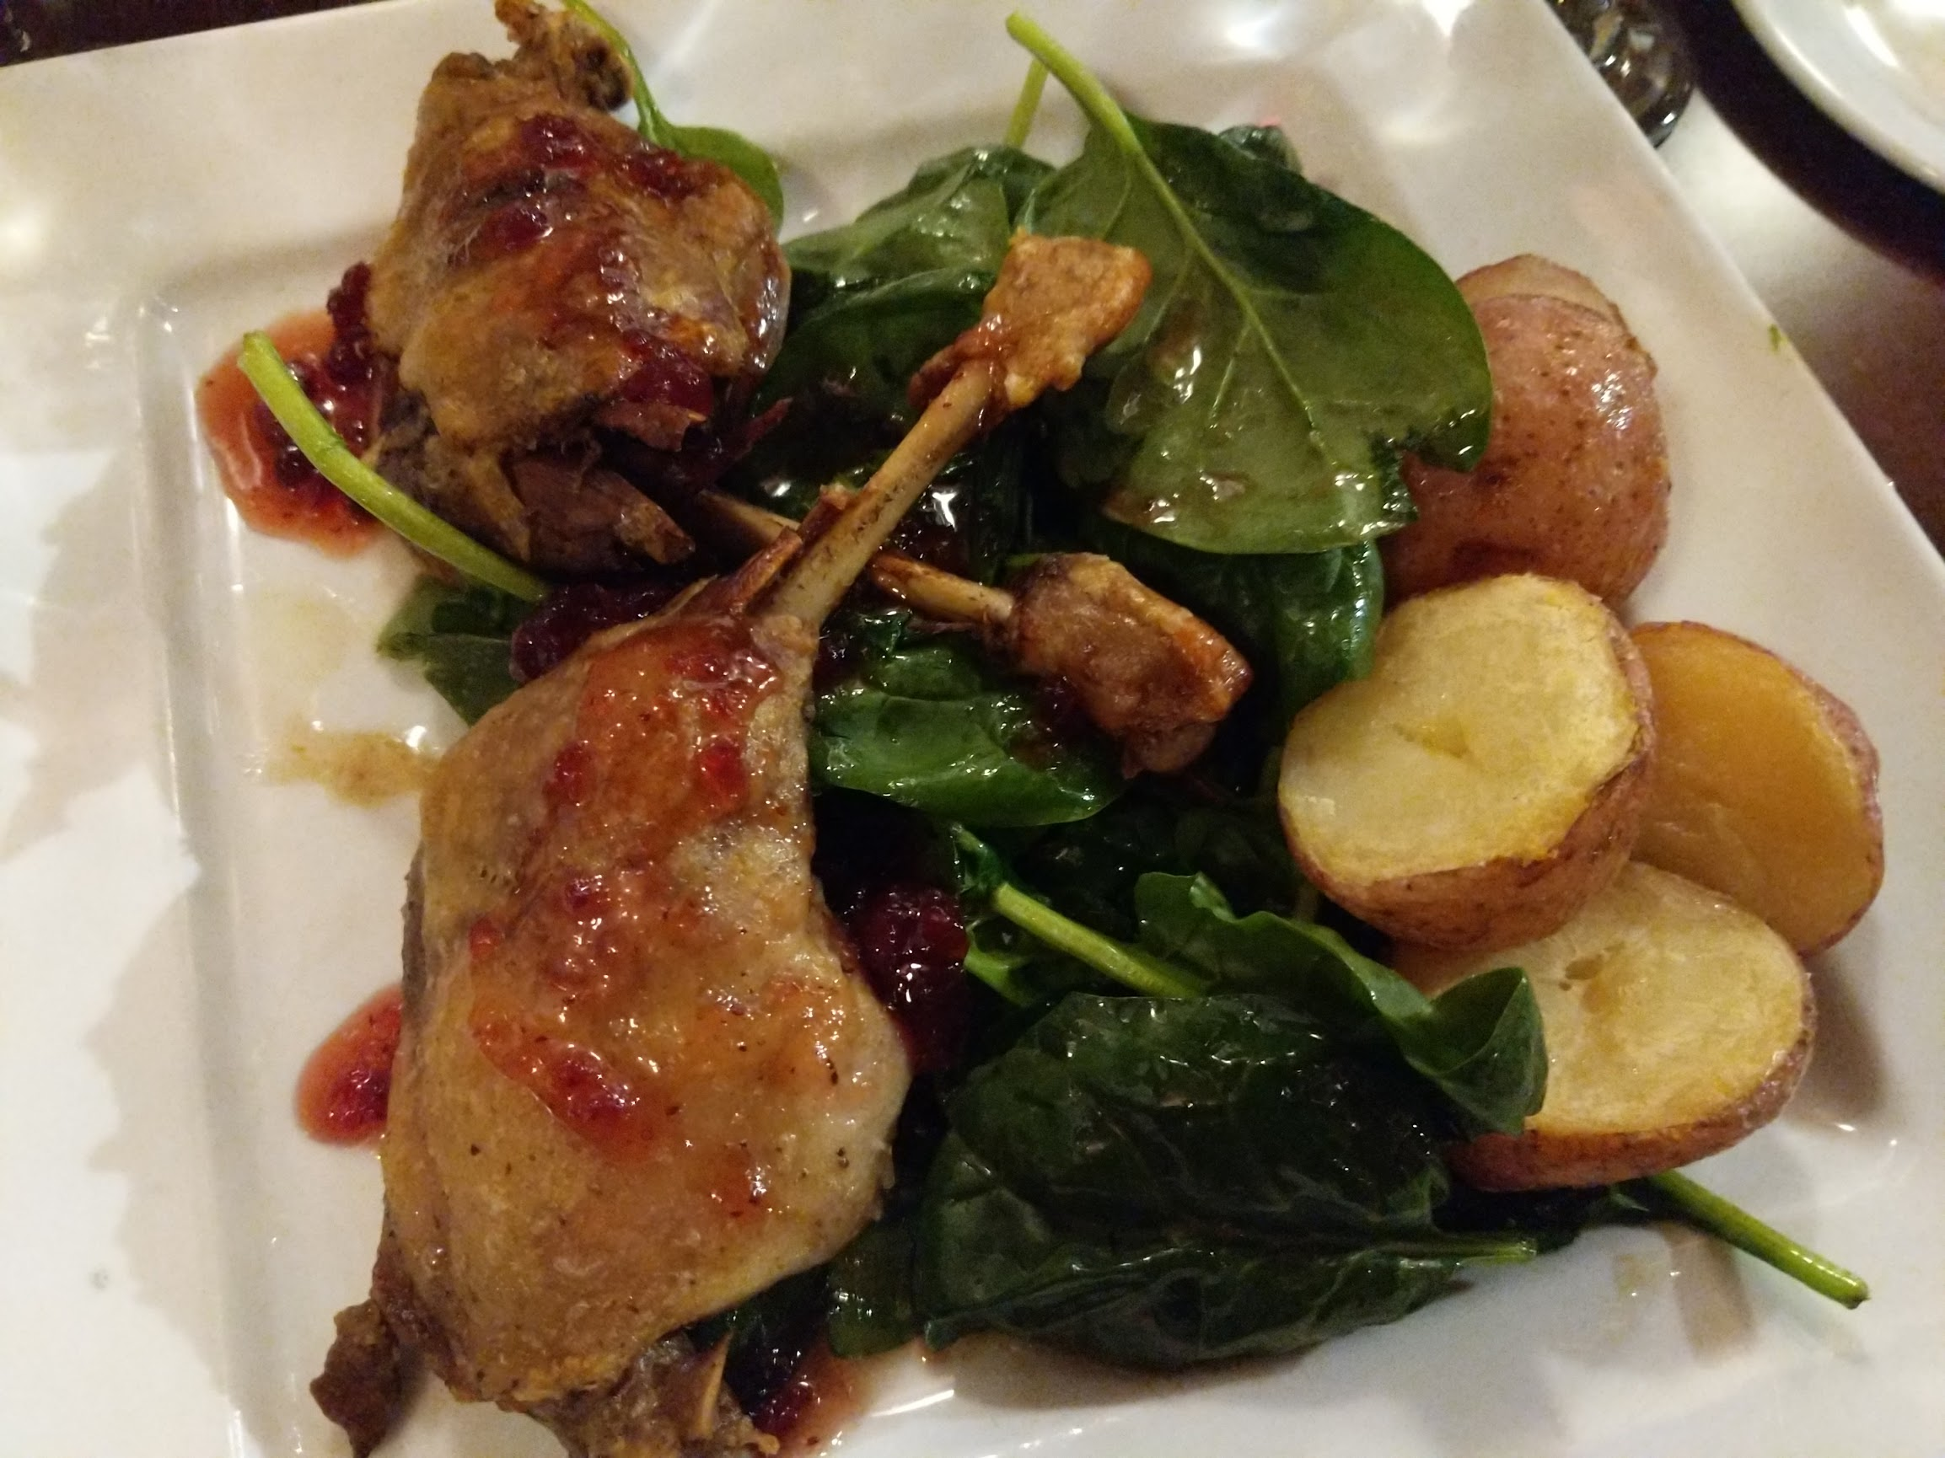
An AppSec Program: The Main Course
Photo: Sarah Godin
Notes:
Explain you are comparing to a meal so they know which parts you need and which parts you just really want.
This list are things your program needs, not stuff that you have to do every single time for every app . It depends on the level of assurance you require. Give example of read-only social calendar versus banking app

Slide 16
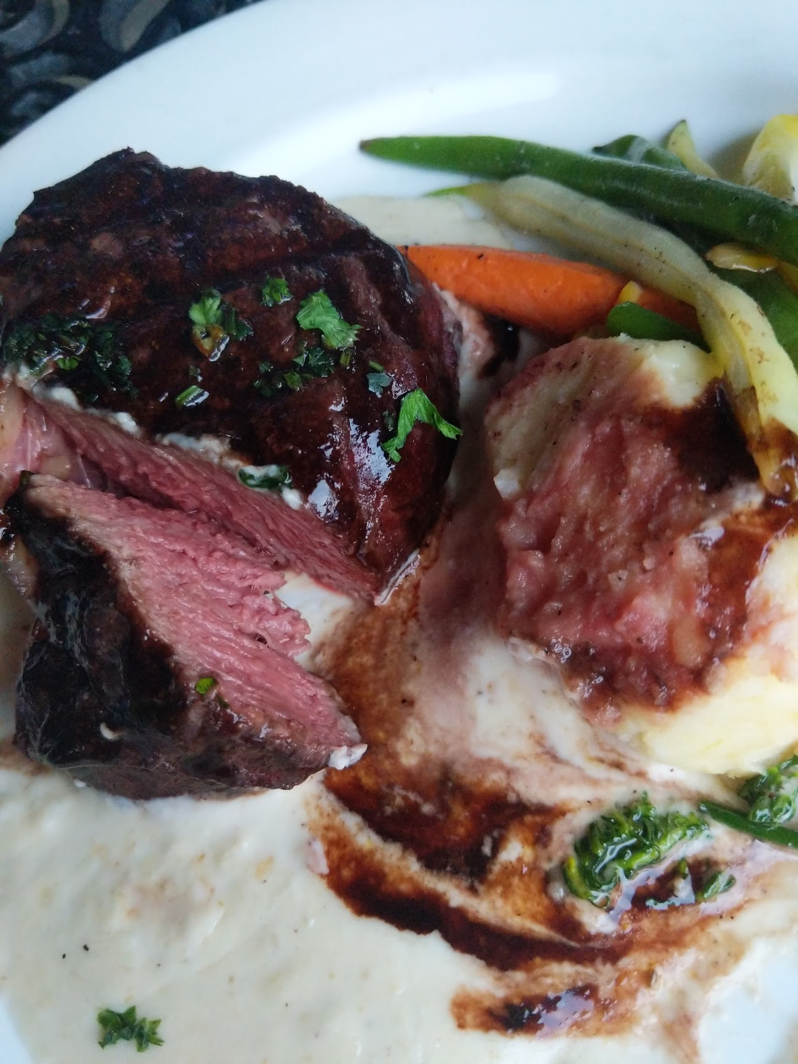
An AppSec Program: Main Course
Vulnerability (VA) Scans and Assessments
Secure Code Reviews (Dependencies,Secrets Management,Static Code Analysis)
Threat Modeling
Penetration Tests (PenTests)
This applies to both Custom
Apps and COTS
Photo: Sarah Godin
Notes:
Explain you are comparing to a meal so they know which parts you need and which parts you just really want.
This list are things your program needs, not stuff that you have to do every single time for every app . It depends on the level of assurance you require. Give example of read-only social calendar versus banking app

Slide 17

An AppSec Program: The Gravy
Photo: Sarah Godin
Notes:
(Does everyone know what this is? It's Poutine, the Canadian National Dish. We eat that!)
Gravy:
Educating Developers on Secure Coding Practices, workshops, talks, lessons
Secure Coding Standards
Responsible/Coordinated Disclosure
Secure code library and other reference materials

Slide 18

An AppSec Program: The Gravy
Educating Developers on
Secure Coding Practices
with workshops, talks,
lessons
Secure Coding Standards
Responsible/Coordinated
Disclosure
Secure code library and
other reference materials,
creating custom tools
Photo: Sarah Godin
Notes:
(Does everyone know what this is? It's Poutine, the Canadian National Dish. We eat that!)
Gravy:
Educating Developers on Secure Coding Practices, workshops, talks, lessons
Secure Coding Standards
Responsible/Coordinated Disclosure
Secure code library and other reference materials

Slide 19

An AppSec Program: Dessert!
Photo: Sarah Godin
Notes:
Dessert:
Bug Bounty Programs
Capture The Flag (CTF) contests
Red Team Exercises

Slide 20
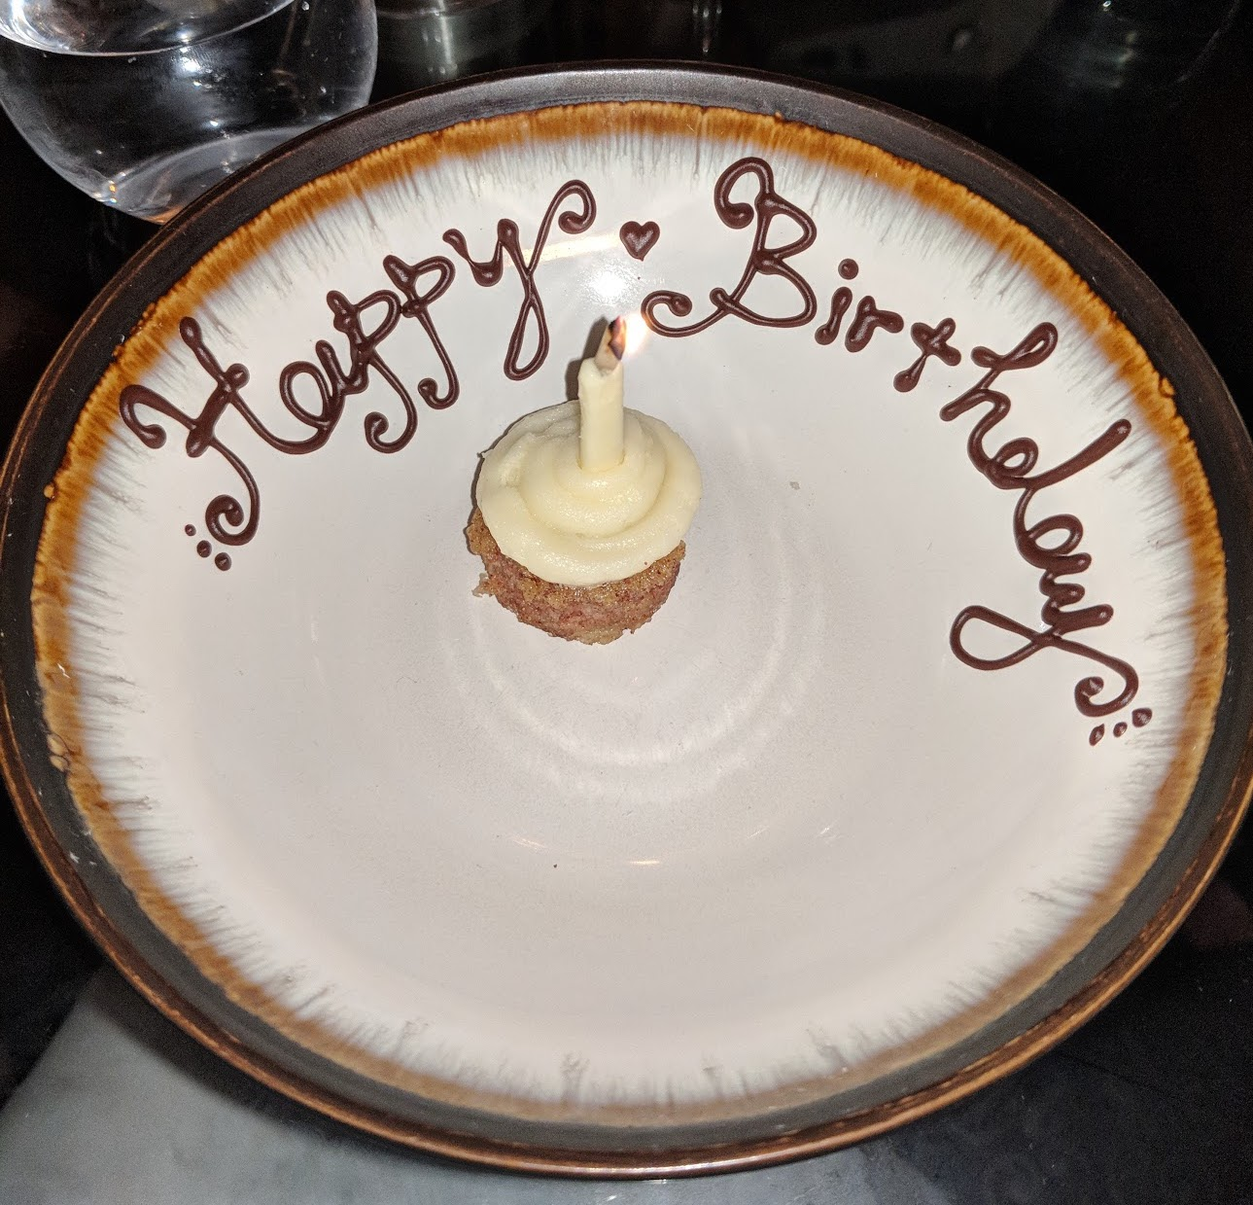
An AppSec Program: Dessert!
Bug Bounty Programs
Capture The Flag (CTF) contests
Red Team Exercises
Photo: Sarah Godin
Notes:
Dessert:
Bug Bounty Programs
Capture The Flag (CTF) contests
Red Team Exercises

Slide 21
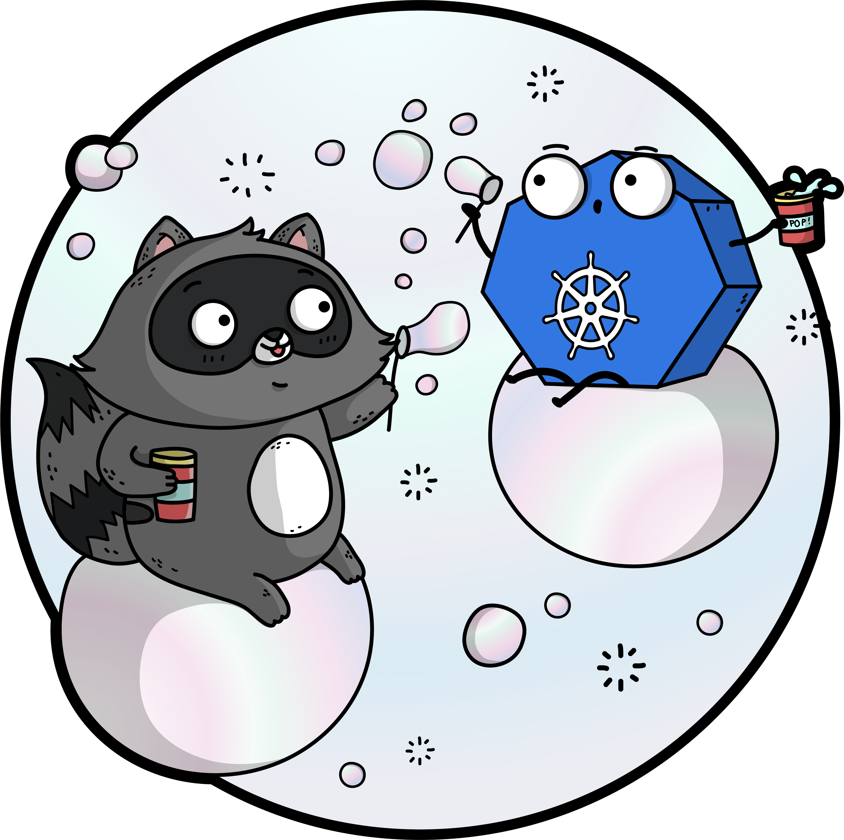
How can YOU ‘push left’?
The Big Question…

Slide 22
Use Docker to integrate tests
A tip/advice

Slide 23
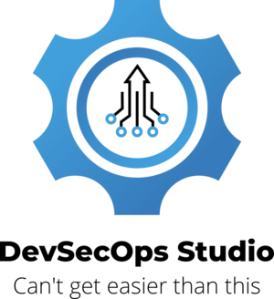
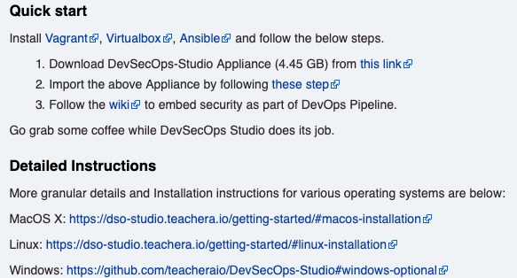
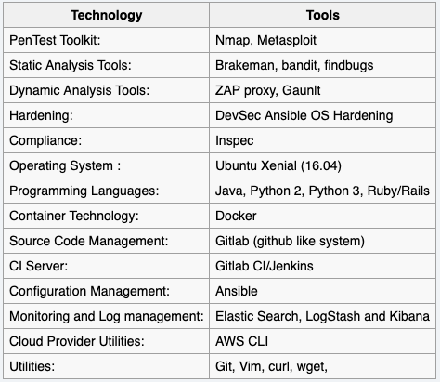
Get a training lab
https://www.owasp.org/index.php/OWASP_DevSecOps_Studio_Project
www.practical-devsecops.com
Notes:
Testing your code
Most people use a web proxy security scanner to test their web applications
It sits between your browser and the internet
It will automate tests for you, tell you what to fix, and, if it's a good one, HOW to fix the issues
There are paid and free options available
Don't use a scanner on an app you don't have permission to test, it's illegal

Slide 24
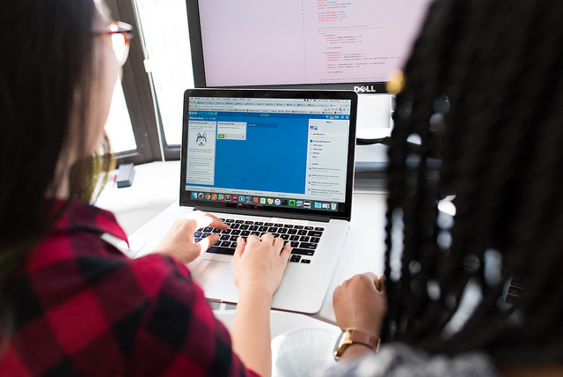
YOU Pushing Left: Testing Your Code
#WOCinTechChat
Notes:
Testing your code
Most people use a web proxy security scanner to test their web applications
It sits between your browser and the internet
It will automate tests for you, tell you what to fix, and, if it's a good one, HOW to fix the issues
There are paid and free options available
Don't use a scanner on an app you don't have permission to test, it's illegal

Slide 25

YOU Pushing Left: Testing Your Code
Most people use a web proxy security scanner to test their web applications
It sits between your browser and the internet
It will automate tests for you, tell you what to fix, and, if it's a good one, HOW to fix the issues
There are paid and free options available
Don't use a scanner on an app
you don't have permission to
test, it's illegal!
#WOCinTechChat
Notes:
Testing your code
Most people use a web proxy security scanner to test their web applications
It sits between your browser and the internet
It will automate tests for you, tell you what to fix, and, if it's a good one, HOW to fix the issues
There are paid and free options available
Don't use a scanner on an app you don't have permission to test, it's illegal

Slide 26
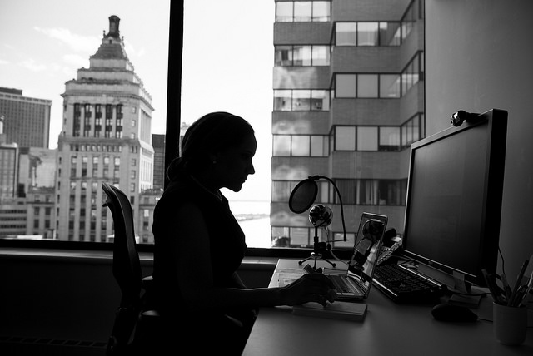
YOU Pushing Left: Testing Your Code
Caution
Caution
#WOCinTechChat
Notes:
Testing your code – a word of caution
Ensure you have permission from your boss before you start, there may be policies against it
Be considerate, scanners can hog resources
Be careful, scanners can be destructive
Back up your data before hand
This is an activity that requires some learning before you can start, to ensure you don't cause any damage or tick anyone off

Slide 27
YOU Pushing Left: Testing Your Code
Caution
Ensure you have permission from your boss before you start, there may be policies against it (ask the security team too!)
Be considerate, scanners can hog resources
Be careful, scanners can be destructive
Back up your data before hand
This is an activity that requires some learning before you can start, to ensure you don't cause any damage or tick anyone off
Inform security when you start and finish
Notes:
Testing your code – a word of caution
Ensure you have permission from your boss before you start, there may be policies against it
Be considerate, scanners can hog resources
Be careful, scanners can be destructive
Back up your data before hand
This is an activity that requires some learning before you can start, to ensure you don't cause any damage or tick anyone off

Slide 28
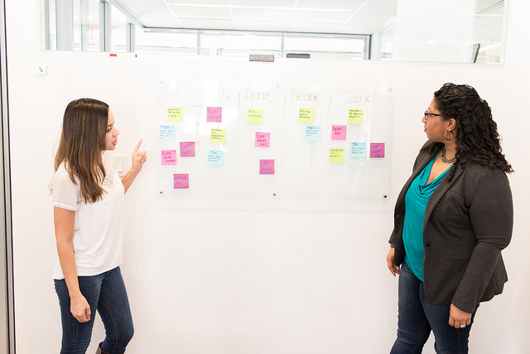
YOU Pushing Left: Threat Modelling
#WOCinTechChat
Notes:
Threat Modeling
Figuring out negative use cases, and ways to defend against them
Basically a brainstorming session with programmers and security to figure out how someone may try to abuse your app
Search you code for these threats
Thinking like an adversary can not only uncover potential issues, it can be fun and educational.

Slide 29

YOU Pushing Left: Threat Modelling
Basically a brainstorming session with programmers and security to figure out how someone may try to abuse your app
Figuring out negative use cases, and
ways to defend against them
Search you code for these threats
Thinking like an adversary can not only
uncover potential issues, it can be
fun and educational.
#WOCinTechChat
Notes:
Threat Modeling
Figuring out negative use cases, and ways to defend against them
Basically a brainstorming session with programmers and security to figure out how someone may try to abuse your app
Search you code for these threats
Thinking like an adversary can not only uncover potential issues, it can be fun and educational.

Slide 30

YOU Pushing Left: Reviewing your code
#WOCinTechChat
Notes:
Reviewing code
Most people use a static code analyzer, but this can also be done manually
Search for your threat models
Even the most expensive tool produces many false positives, the 'work' in this exercise is figuring out what is a real issue and what is not
Paid and free options, plus language-specific
You can find more than just security bugs

Slide 31
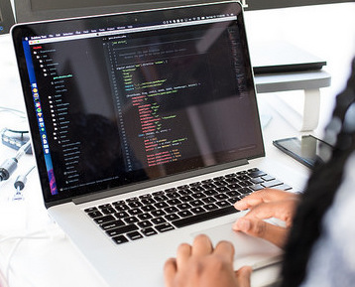
YOU Pushing Left: Reviewing your code
Most people use a static code analyzer, but this can also be done manually
Search for your threat models
Even the most expensive tool produces many false
positives, the 'work' in this exercise is figuring out what is a real issue and what is not
OWASP Dependency check
You can find more than just
security bugs
#WOCinTechChat
Notes:
Reviewing code
Most people use a static code analyzer, but this can also be done manually
Search for your threat models
Even the most expensive tool produces many false positives, the 'work' in this exercise is figuring out what is a real issue and what is not
Paid and free options, plus language-specific
You can find more than just security bugs

Slide 32

YOU Pushing Left: Writing better code
#WOCinTechChat
Notes:
You might think this slide is condescending, but it's not. Just like the best professional athletes, you don't have to stop improving at 5:00 pm. Just like the practice and try new techniques to improve their craft, so can you. Because you can have the fastest, most beautiful app that does everything your client asked for, but it if it's not secure, it's not the best.

Slide 33
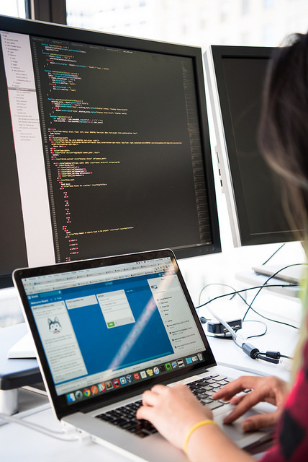
YOU Pushing Left: Writing better code
Train yourself on secure coding practices
There are many quality online resources, free and paid, as well as courses and conferences
Check online for the best and most secure way to do things, before you start coding
Become the security expert on your dev team, and help the rest of your team learn
#WOCinTechChat
Notes:
Train yourself on secure coding practices
There are tons of quality online resources, free and paid, as well as courses and conferences
Check online for the best and most secure way to do things, before you start coding
Become the security expert on your dev team, and help the rest of your team learn

Slide 34
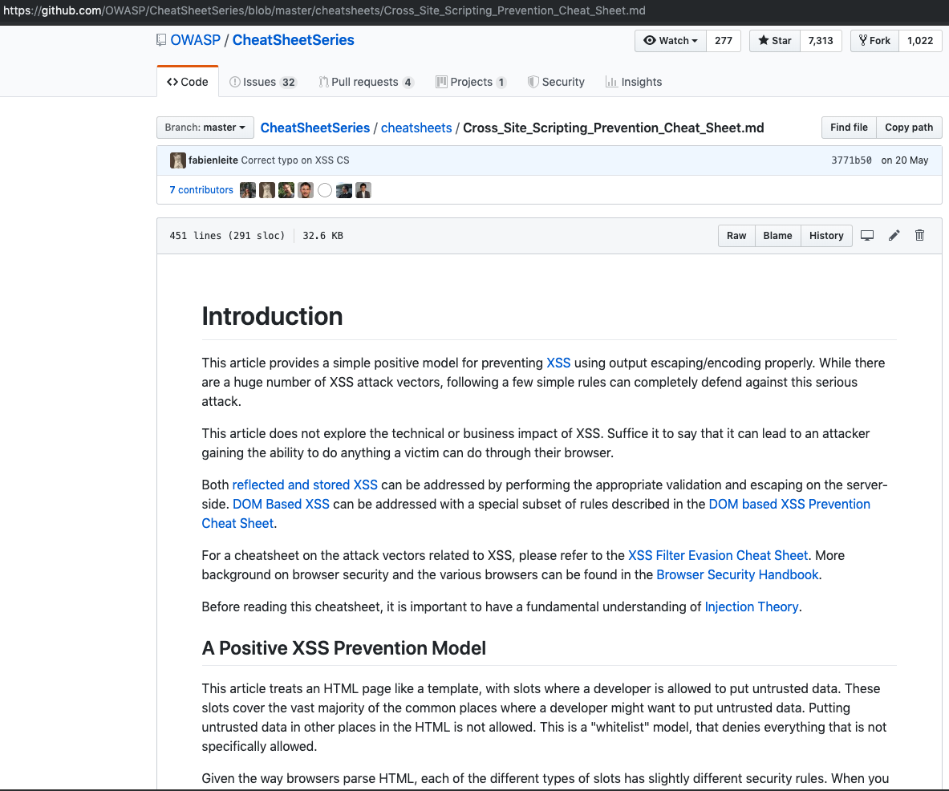
Writing better code: Use OWASP Cheat Sheets
Notes:
Train yourself on secure coding practices
There are tons of quality online resources, free and paid, as well as courses and conferences
Check online for the best and most secure way to do things, before you start coding
Become the security expert on your dev team, and help the rest of your team learn

Slide 35
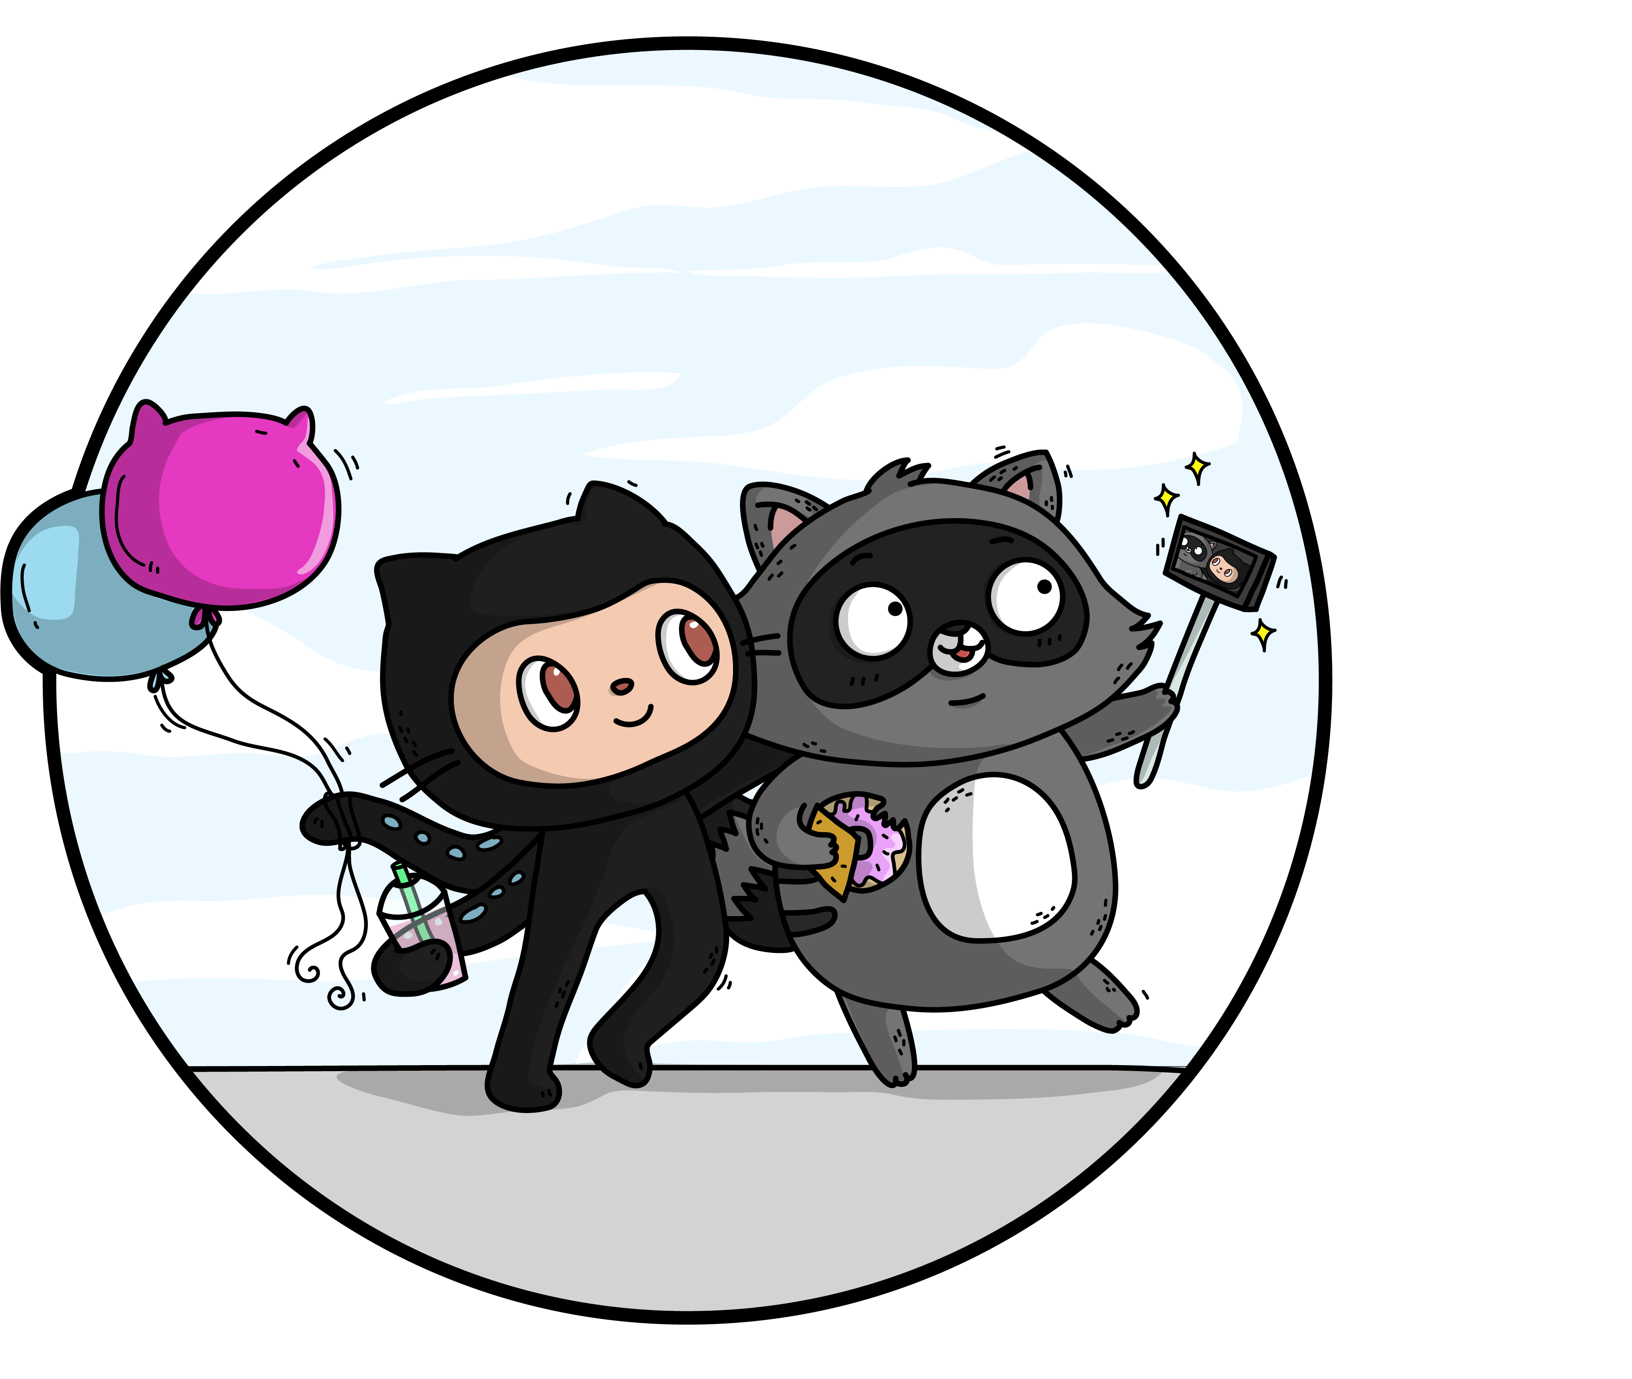
Resources
A long-term (AppSec)
relationship

Slide 36
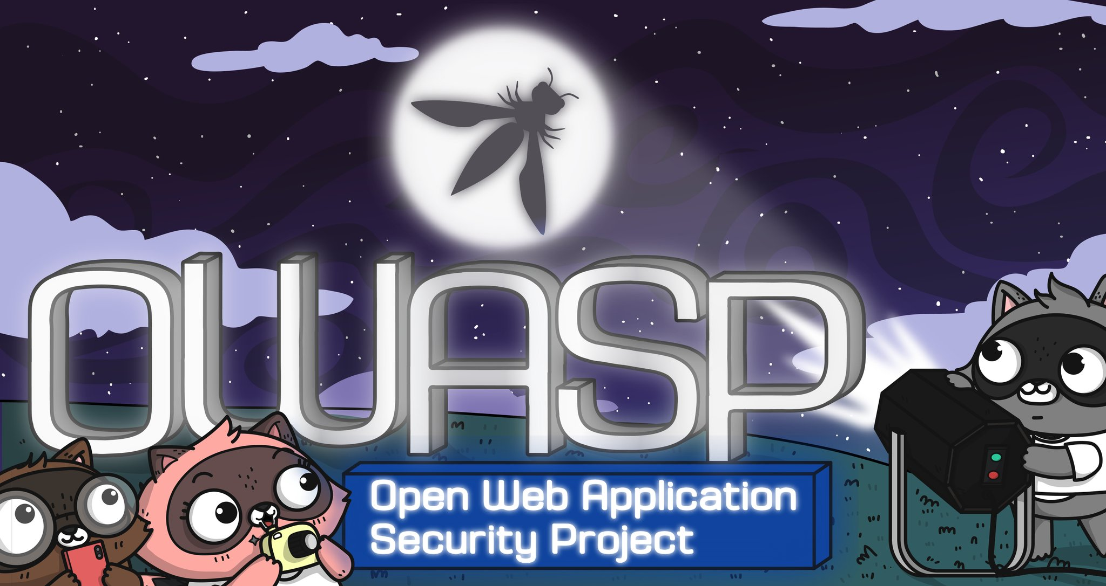
OWASP: Your new BFF
Open Web Application Security Project
Notes:
Joining OWASP, attending meetings and/or using their resources, will set you apart from your peers.
There is so much more that you can learn and do than what was shown in this presentation.
There are a lot of jobs in this field, in case you like it, and it pays well. It is estimated that there are 1.5 million security jobs in North America for which there is no security person to do them.
We need more people in this industry, badly. Join us.
Tell them about DevSlop! ☺

Slide 37
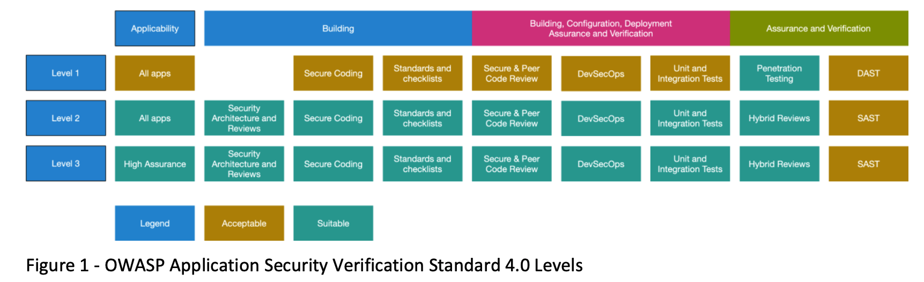
OWASP ASVS (AppSec Verification Standard)
https://www.owasp.org/index.php/Category:OWASP_Application_Security_Verification_Standard_Project

Slide 38
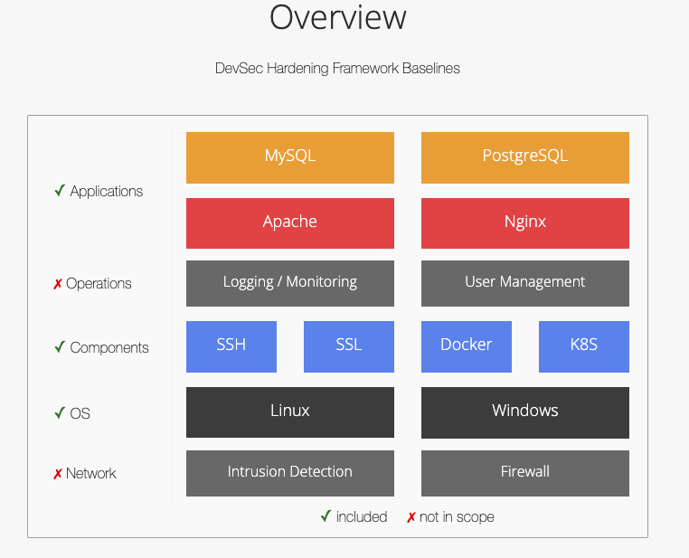
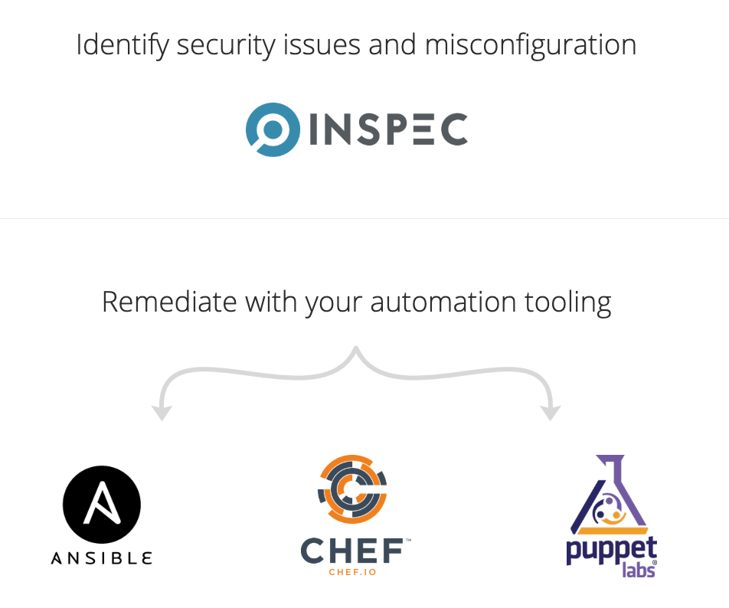
Dev-Sec – Server Hardening automation
Dev-sec.io

Slide 39
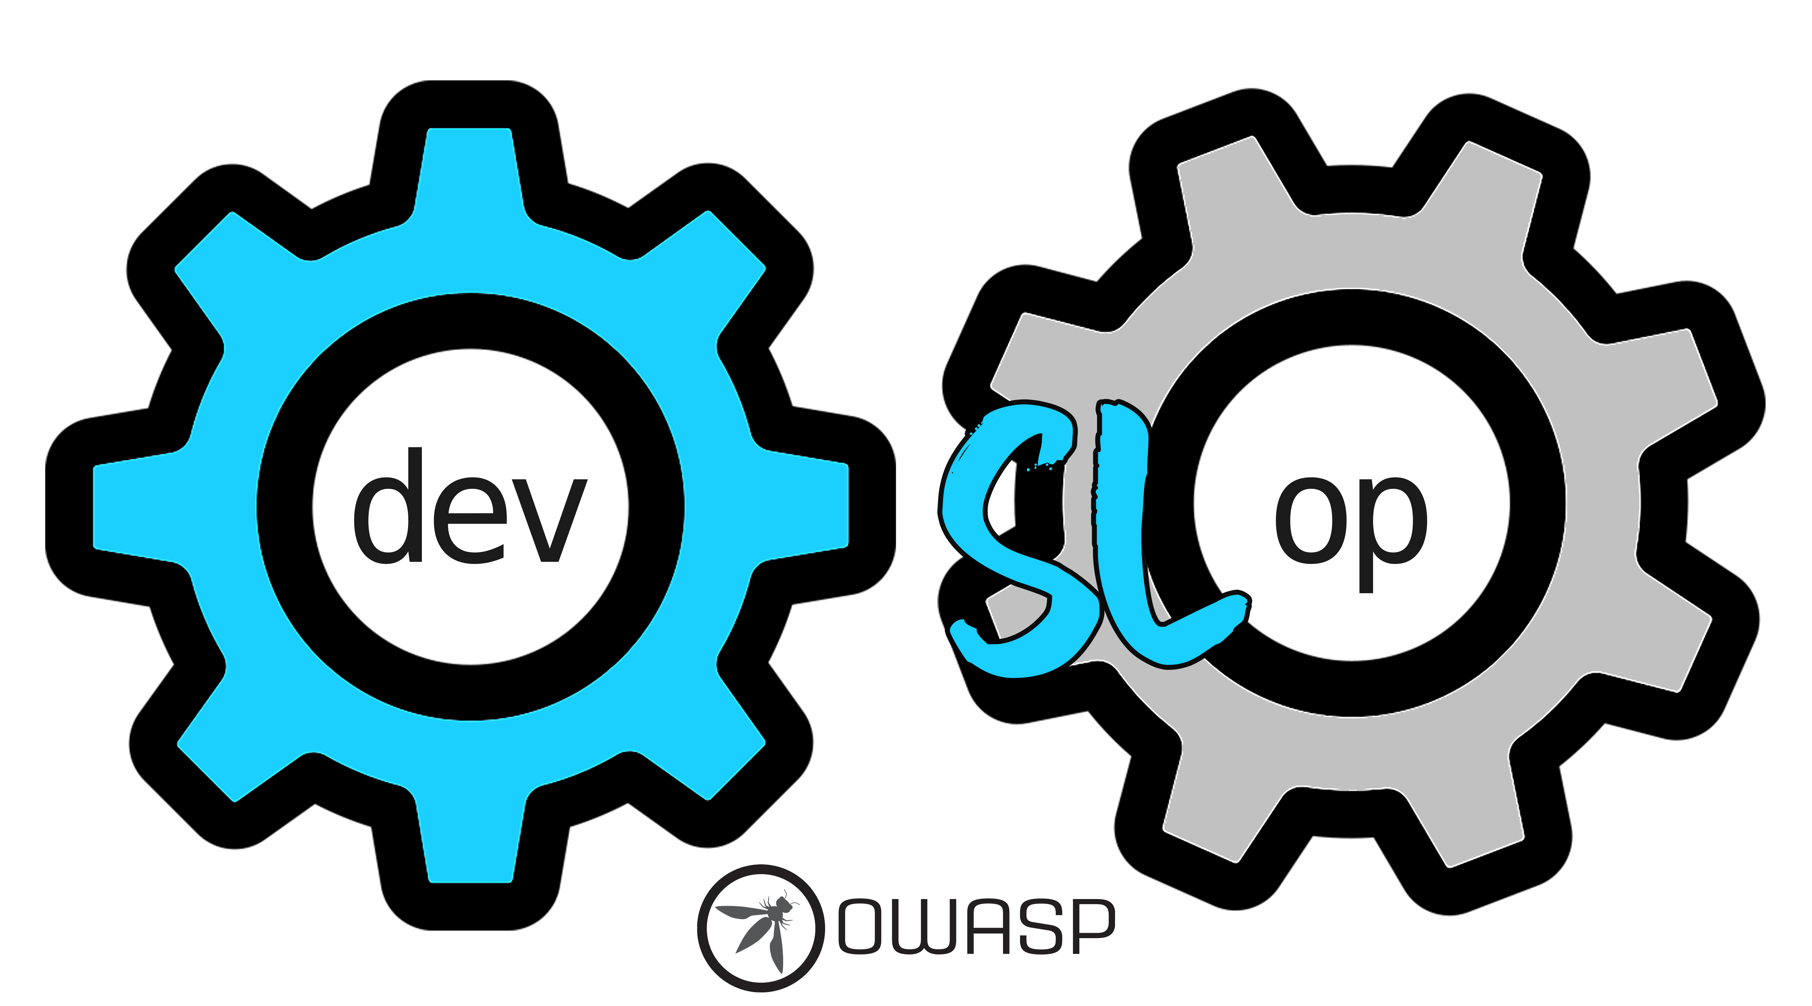
OWASP DevSlop Has Your Back
DevSlop.co

Slide 40
Resources
Links for Getting Started in Application Security
https://aka.ms/GettingStartedWithAppSec
Notes:
We eat our own dogfood, and we do DevOps for all of our products. If you want to know more, check out our journey
https://stories.visualstudio.com/

Slide 41
Resources
Follow Tanya Janca?
Twitter: @SheHacksPurple
https://medium.com/@SheHacksPurple
https://youtube.com/SheHacksPurple
https://Dev.TO/SheHacksPurple

Slide 42
Resources
Follow Mario Platt
Twitter: @madplatt
https://medium.com/@marioplatt
LinkedIn: https://www.linkedin.com/in/marioplatt/

Slide 43
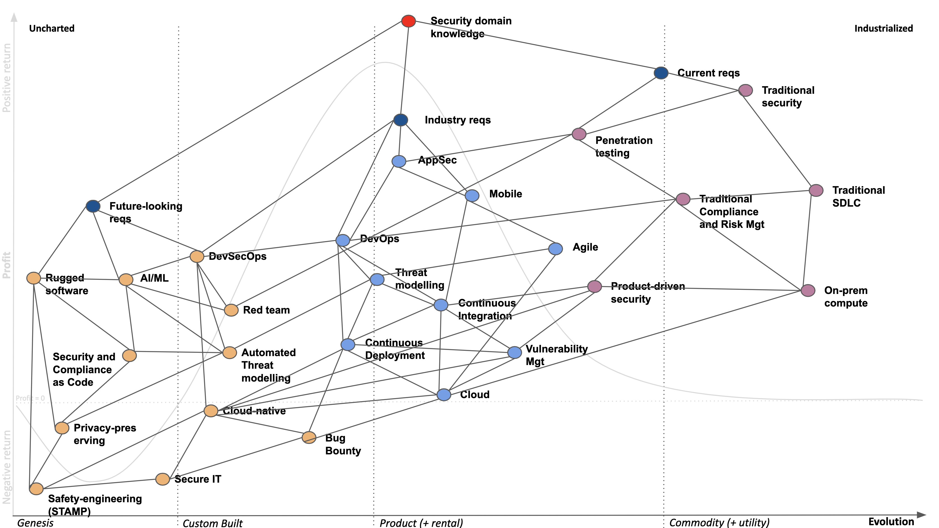

Slide 44
Follow Mario Platt
Twitter: @madplatt
https://medium.com/@marioplatt
LinkedIn: https://www.linkedin.com/in/marioplatt/

Slide 45
Thank you
Mario Platt

